Slide 1

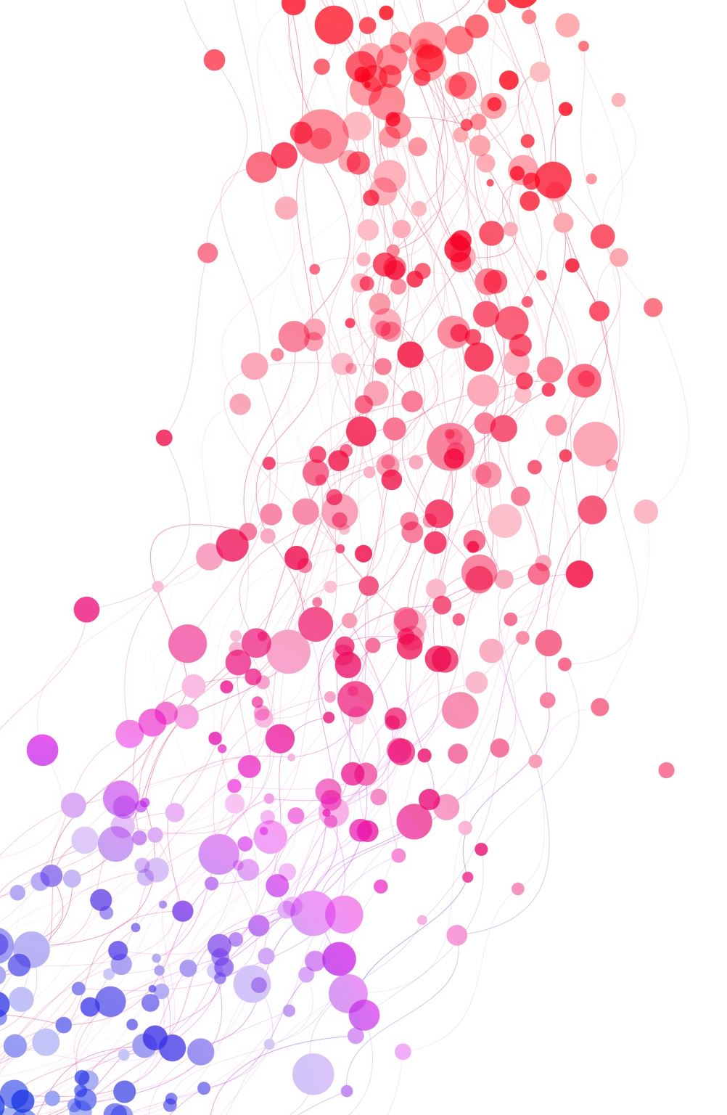
BUILD AND TRAIN A MACHINE LEARNING MODEL IN AMAZON SAGEMAKER
TEAM MEMBERS-
2000031914-R.LIKHITH KUMAR
2000031686-K.MANIKANTA

Slide 2
WHAT IS AMAZON SAGEMAKER??
Amazon SageMaker is a managed service in the Amazon Web Services (AWS) public cloud. It provides the tools to build, train and deploy machine learning (ML) models for predictive analytics applications. The platform automates the tedious work of building a production-ready artificial intelligence (AI) pipeline.Machine learning has a range of uses and benefits. Among them are advanced analytics for customer data and back-end security threat detection.Deploying ML models is challenging, even for experienced application developers. Amazon SageMaker aims to simplify the process. It uses common algorithms and other tools to accelerate the machine learning process

Slide 3
INTRODUCTION
Artificial Intelligence & Machine learning is the most exciting and disruptive area in the current era. AI/ML has become an integral part of research and innovations. The main objective of the AI system is to solve real-world problems where businesses are concerned about profitability, sustainability, brand image, cost structure, customers, to compliance. AI products & solutions will be easily adopted by businesses and organizations when this is integrated with the broader enterprise system and consumer-facing organizations can use it to enrich their customers’ experiences. This article will mainly deal with the Machine Learning model in AWS Sagemaker. A serverless architecture exposes the runtime inference endpoint available to client software running on consumer devices. REST is a well-architected web-friendly approach and is used to integrate the inference endpoint with the broader enterprise application. I will describe the step-by-step code and set up to deploy an ML model in AWS Sagemaker using serverless architecture. The journey from POC to Production is complex and time-consuming. AWS Sagemaker is an advanced Machine Learning platform which is offering a broad range of capabilities to manage large volumes of data to train the model, choose the best algorithm for training it, manage the scalability, capacity of infrastructure while training it, and then deploy & monitor the model into a production environment.

Slide 4
PROBLEM
When we are talking about the data-driven value of Machine Learning systems, customer analysis is always drawing everyone’s interest. There is huge churn in the mobile industry due to the large volume of customers and various service providers. Mobile operators have historical records on which customers ultimately ended up churning and which continued using the service. Leaving customers effect the business revenue badly. Hence mobile company wants to predict such customers in advance so that they can be retained with additional discount/offers etc.

Slide 5
SOLUTION
I am going to build a model with the customer dataset. The data is the historical data. The dataset has the customer behaviour, transaction details which will help the algorithm to detect the pattern and predict the customer churn. The operation team will use this data along with other CRM data and try to retain the customer whose churn prediction is high.

Slide 6
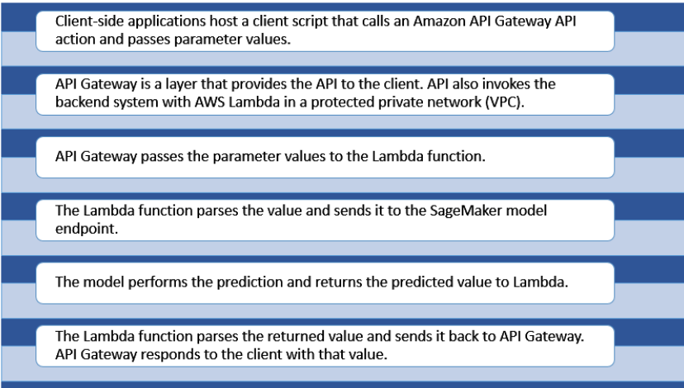
ARCHITECTURE

Slide 7
CONCLUSION
Any data science project starts with an iterative process of Data engineering, model development, model optimization, model evaluation, and finally the best fit model is delivered.
Then we face the major challenge to integrate the ML model with the existing IT and business system. A successful AI adoption needs a seamless integration between ML workflow and the consumer application. AWS API Gateway along with Sagemaker endpoint and Lambda offers a managed integration service that enables us to build end-to-end production-ready ML systems.
This step-by-step guide can help to build the basic integration architecture and then we can build other infracting components.

